Slide 1

Heart disease in america
Trevor Richardson &
Chi yun liu

Slide 2
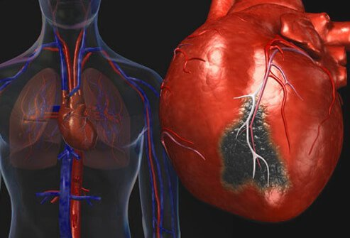
Background
Leading cause of death in the US
655,000 Americans die per year
Costs the US about $219 billion per year
Affects individual populations differently
Notes:
Per the statistics gathered by the CDC

Slide 3
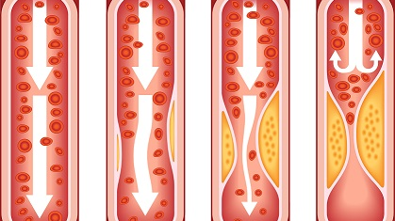
Heart disease
Most common cause is coronary artery disease
Plaque builds up in arteries causing arteries to narrow
Often, plaque breaks off from buildup and leads to complete blockage in arteries
Leads to loss of blood flow to heart muscle ultimately leading to death of heart muscle
Caused by obesity, diet, physical inactivity and excessive alcohol use

Slide 4

Dataset used
Use dataset from Centers for Disease Control and Prevention
Data gathered in adults age 35+ from 2013-2015, and includes variables such as: State, county, race/ethnicity, gender and rates per hundred thousand
In medical statistics, the standard of measure is rates per 100,000.

Slide 5
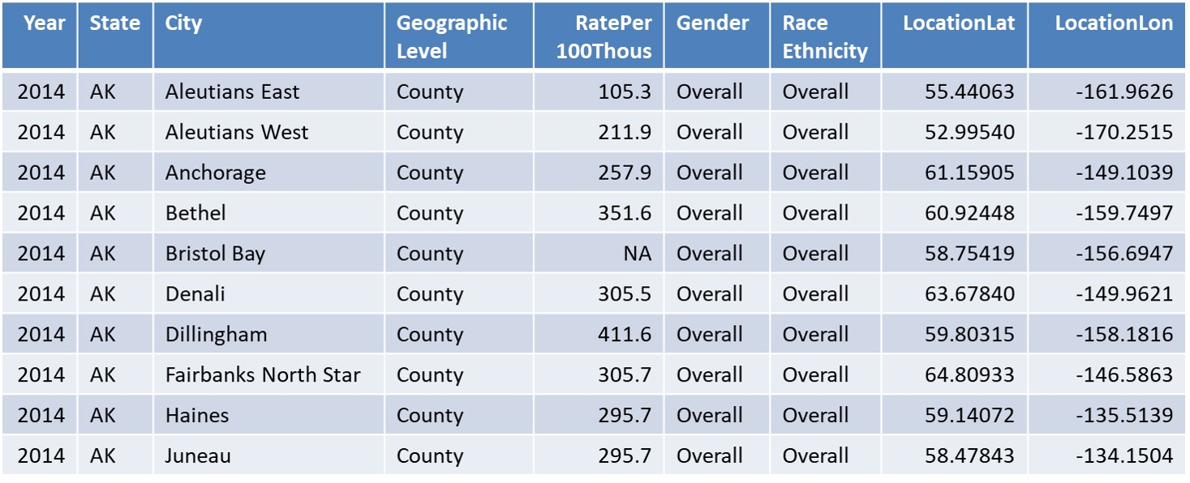
What the dataset looks like
Notes:
This is what the dataset looks like after we filtered out all the other variables that were not useful for our research. It is important to note that the maps package relied on the FIPS code and we were able to obtain a fips file and matched it with this dataset so that we were able to plot the data onto the maps.

Slide 6



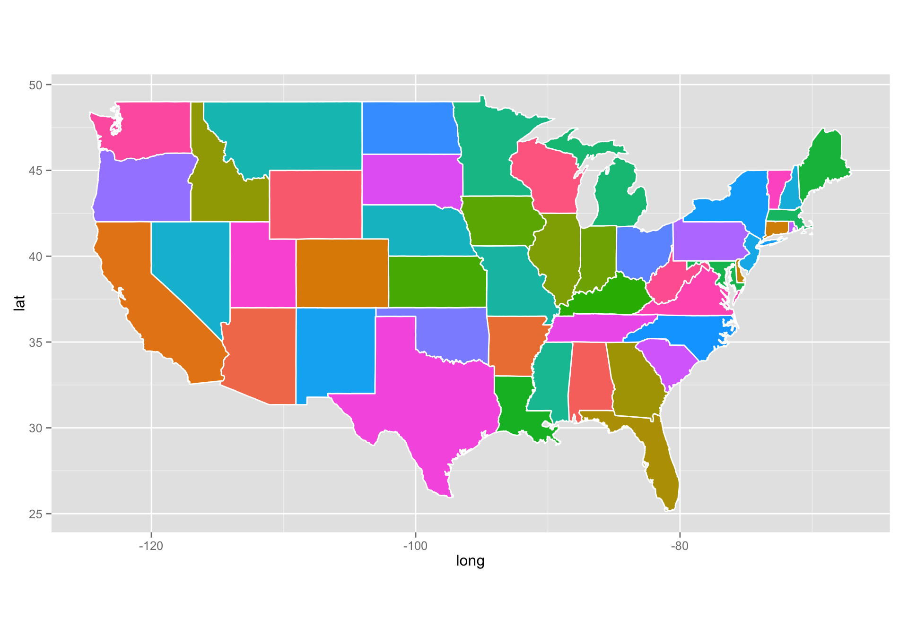
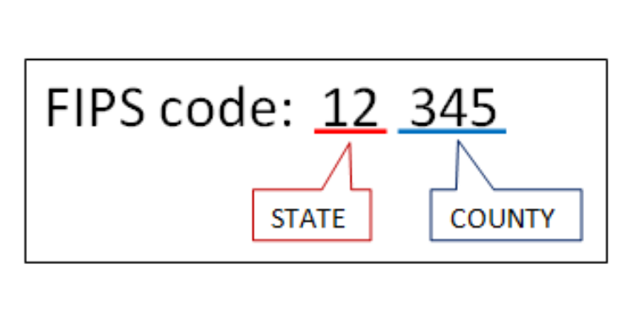
Packages used
Tidyverse
Usmap
Ggplot
tidycensus

Slide 7
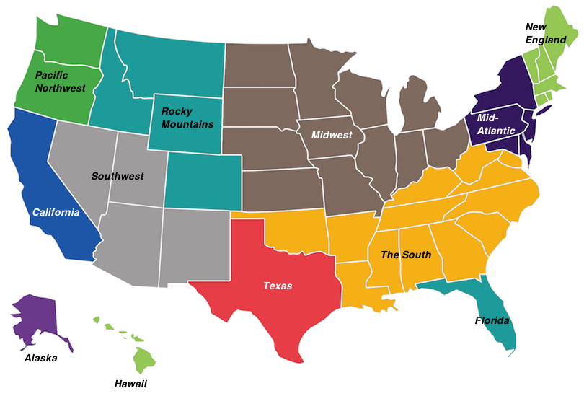
Heart disease by region
Heart disease affects regions differently
“The south” region of the US affected disproportionately (HYPOTHESIS #1)
“The South” is commonly referred to as the stroke belt (Howard et al., 2019)
Notes:
Heart disease affects the numerous regions of the United States Differently. In this case, “The South” is affected disproportionately due to a few factors such as the southern states have a larger portion of African Americans and African Americans have higher rates of heart disease.

Slide 8
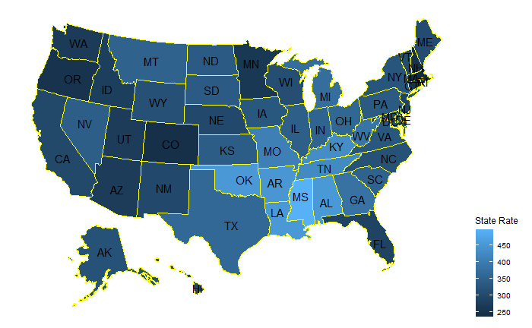
Heart disease rates by state
Notes:
As noted, the southern states are a lighter shade of blue indicating a higher rate of heart disease.

Slide 9
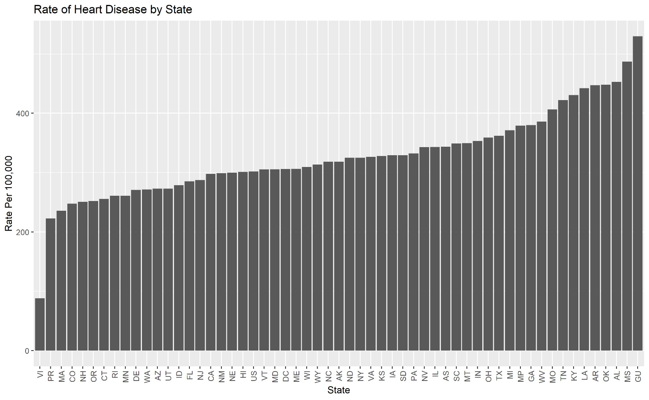
Notes:
The chart shows the rates compared to other states. The dataset includes United States territories: Guam, Virgin Islands and Puerto Rico, since they are technically considered US states, we did not omit the data. As noted by the chart, the highest rates of heart disease are in the states Alabama, Mississippi, and Oklahoma.

Slide 10

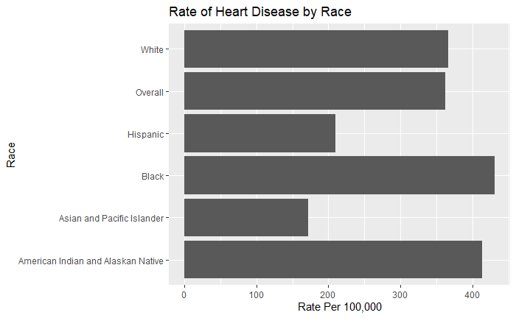
Heart disease by race/ethnicity
Heart disease affects each race/ethnicity differently
African Americans affected disproportionately (HYPOTHESIS #2)
African Americans have higher rates of poverty and lack of access to health care (Yancy, 2005)
Notes:
The dataset included a race and ethnicity variable, so we can manipulate and plot the data to show heart disease by race/ethnicity. Upon initial look, we hypothesized that African Americans have higher rates of heart disease and the data supports that hypothesis. Factors as to why African Americans have higher rates of poverty are attributed to African Americans having higher rates of poverty and lack of access to health care. There are also systematic racism that is largely a factor as well.

Slide 11

Heart disease by gender
Heart disease affects men disproportionately (HYPOTHESIS #3
Biological, behavioral, and psychosocial factors differ in men (Weidner, 2000)
Notes:
The dataset includes a gender variable. Upon first look we hypothesized that men have higher rates of heart disease and that is supported by the dataset.

Slide 12
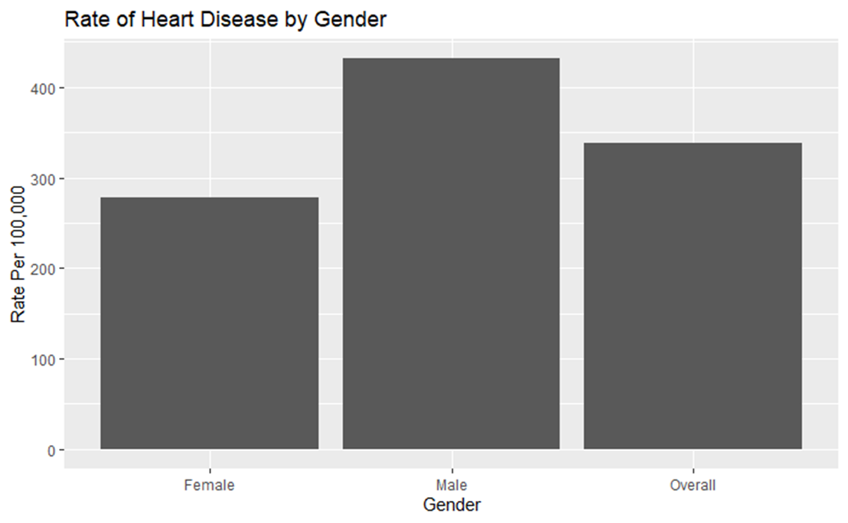
Notes:
Men have higher rates due to different factors that affect men differently, for example, men tend to cope with stress by consuming alcohol and men have higher rates of smoking habits.

Slide 13
Data driven Hypothesis
Dataset includes data by county,
Explore if heart disease rates differ in urban versus rural areas.
Hypothesize that rates are lower in metropolitan/urban areas versus rural areas
Use data in top 3 states in the US: Mississippi, Alabama and Oklahoma
Notes:
The dataset included a by county variable, so we hypothesized that rates of heart disease are higher in rural areas versus the urban metro areas. Our top three states in regards to heart disease are Alabama, Mississippi and Oklahoma so we will look at those states.

Slide 14
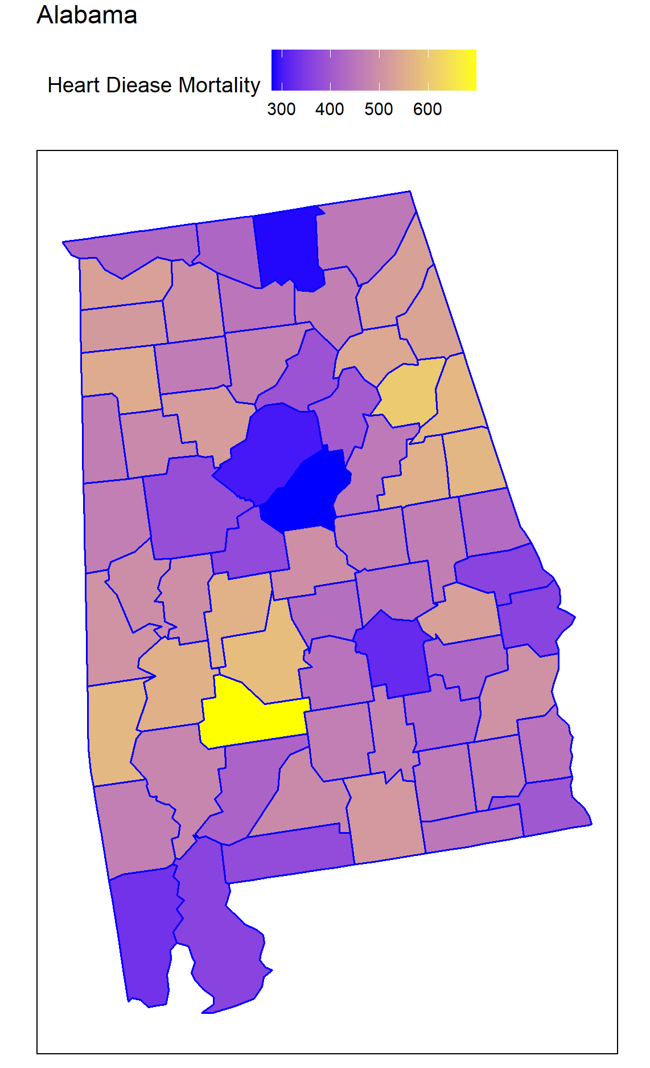
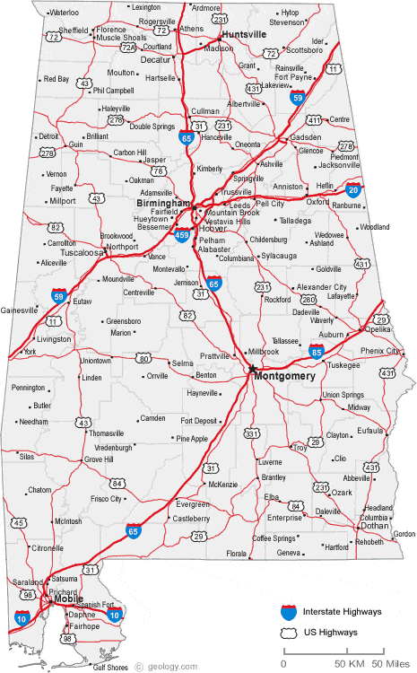
Alabama
Darker areas on map are major cities
Lighter areas are rural areas
Notes:
The Dark blue areas are major cities in Alabama, the most populous city is Birmingham and is in the middle of the state where it is dark blue on the map. The county with the highest rates of heart disease is indicated by the yellow color and is largely rural.
Factors that largely contribute to this disparity are higher rates of obesity, higher rates of poverty and higher rates of unemployment.

Slide 15
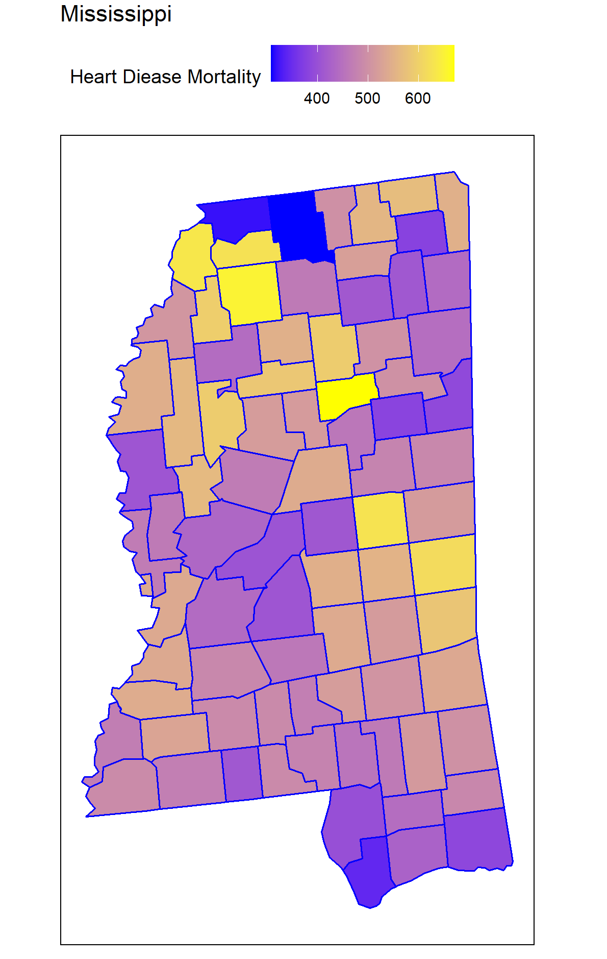
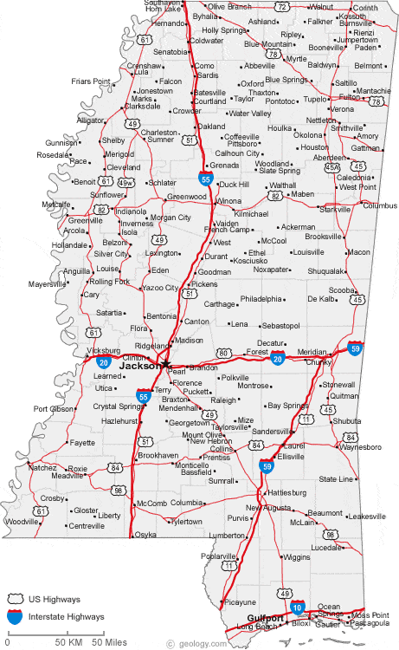
Mississippi
Notes:
The same thing is seen here. The Dark blue on the upper west side of the state is the metropolitan area of the city of Memphis in Tennessee. Directly below it is
a largely rural area.

Slide 16
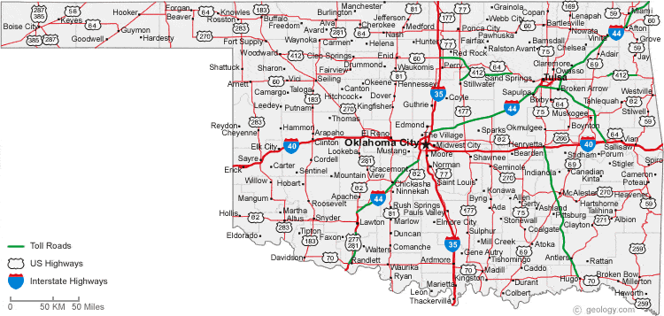
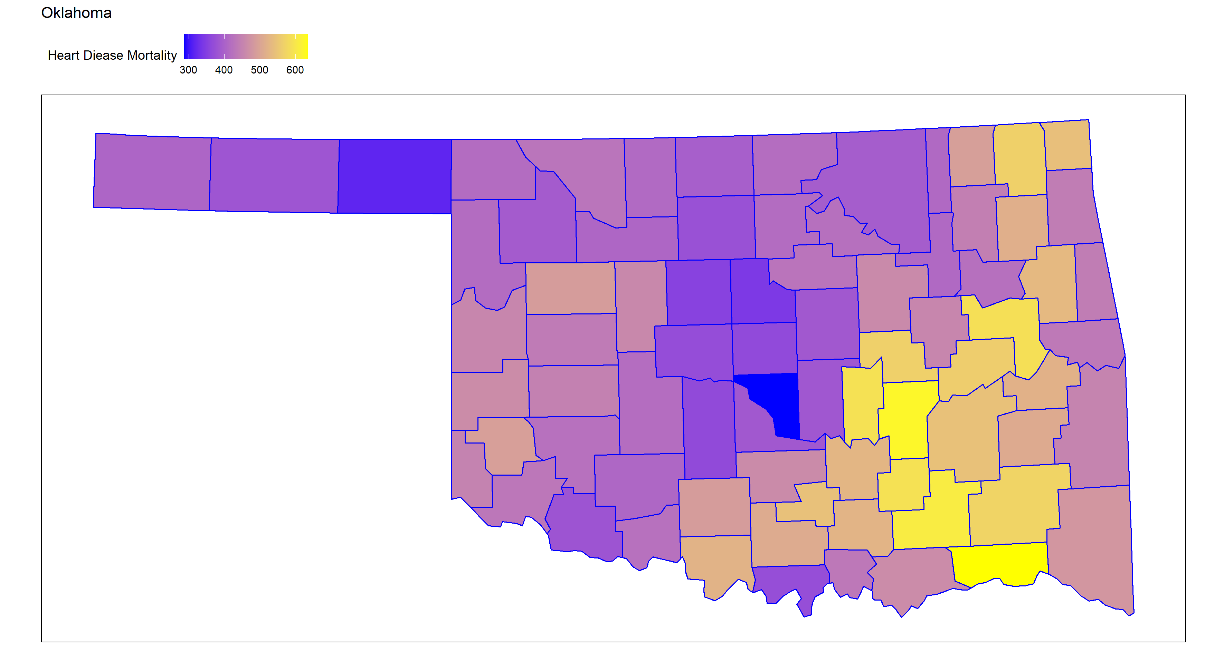
Oklahoma
Notes:
Same thing is seen here, the dark blue is Oklahoma City and to the east of it is a largely rural area. An important note is that to the east of Oklahoma is largely composed of Indian reserves and Native Americans have very high rates of heart disease.

Slide 17

Data driven hypothesis
Explore rates of heart disease in men and women by race to see if disproportionality exists in all races.
Hypothesize that the disproportionality is smaller in African Americans versus white Americans
Notes:
Since the dataset included a gender and ethnicity variable, we were interested in seeing if the disparity is the same between males and females between all races. For example, with African Americans do females have higher rates of heart disease than African American males.

Slide 18
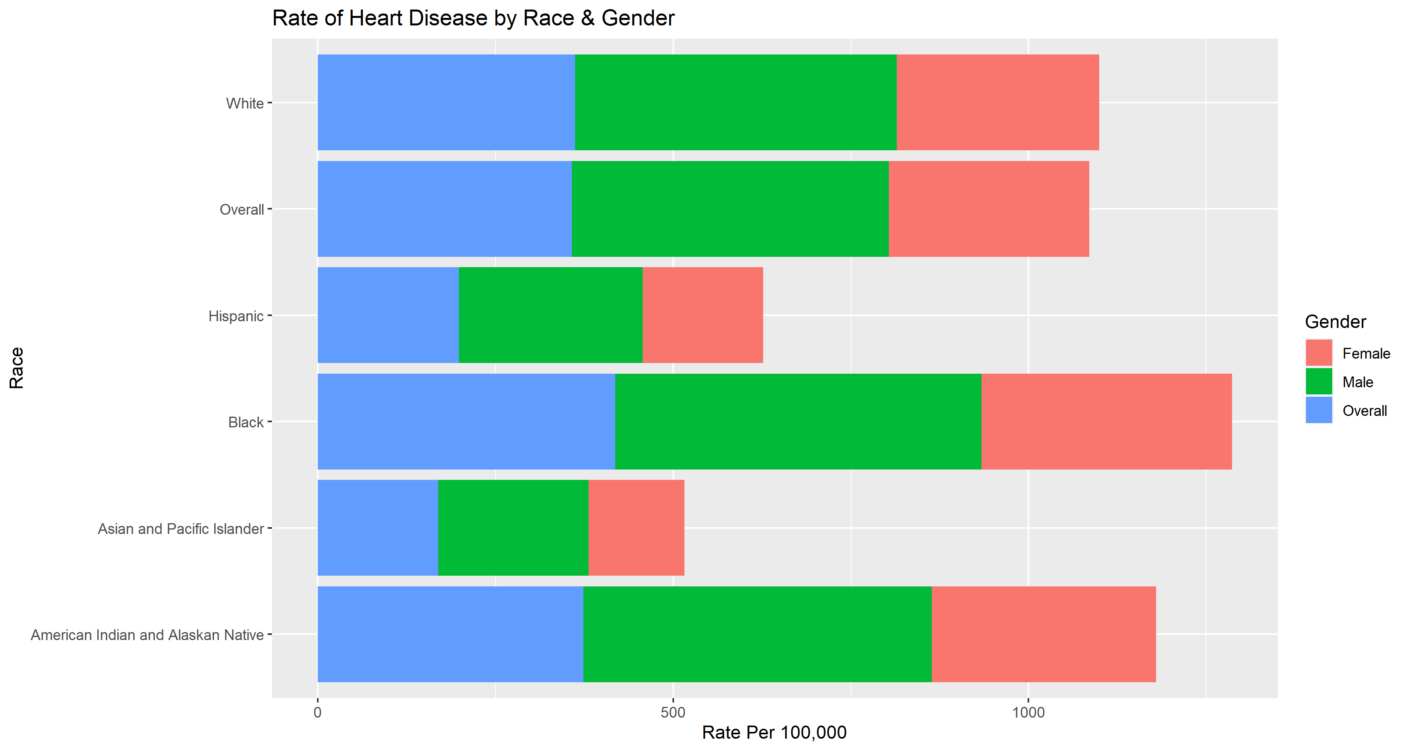
Notes:
As seen here, the disparity is almost equal between all races whereas males have higher rates of heart disease than men.

Slide 19
Citations
George Howard, Darwin R. Labarthe, Jianfang Hu, Sarah Yoon, Virginia J. Howard, (2007) Regional Differences in African Americans' High Risk for Stroke: The Remarkable Burden of Stroke for Southern African Americans, Annals of Epidemiology, 17(9), 2007, 689-696,
Weidner G. (2000). Why do men get more heart disease than women? An international perspective. Journal of American college health : J of ACH, 48(6), 291–294. https://doi.org/10.1080/07448480009596270
Yancy, C. (2005). Heart Failure in African Americans. The American Journal of Cardiology: Division of Cardiology, 96(7), 3-12

Slide 20


